Slide 1
Object Oriented Programming Concepts

Slide 2
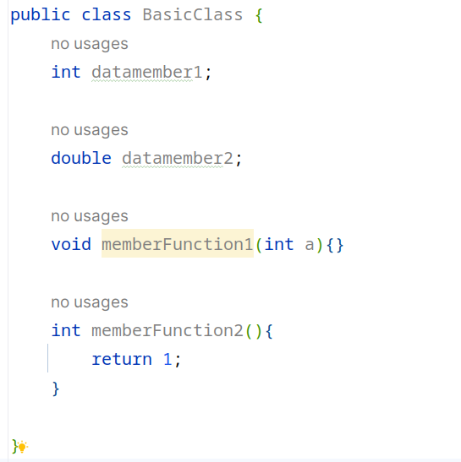
Fundamentals of Class and Object : Class
Blueprint of object
Consists of data members and member functions

Slide 3
Fundamentals of Class and Object : Object
Objects are instance of a class that holds the properties of the classes.
Creating Object
Declaration
instantiation
initialization
new keyword is used to create a object
ClassName objectName = new ClassName();

Slide 4
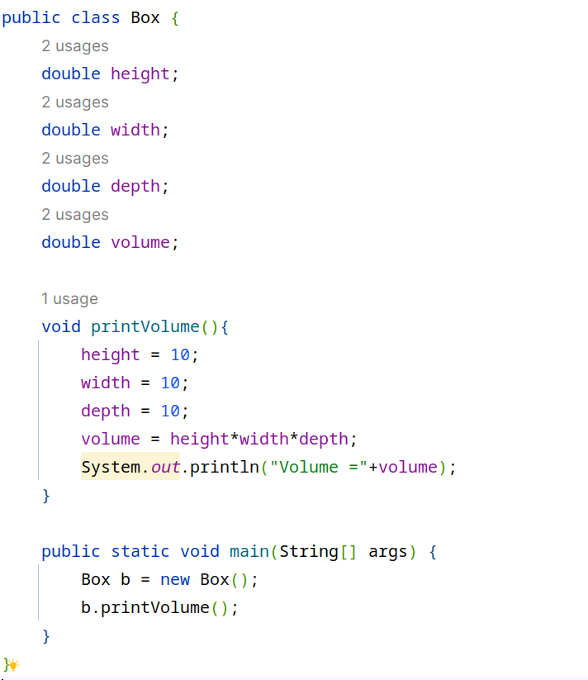

Fundamentals of Class and Object : Methods and their invocation
Methods defined inside a class can be invoked through object

Slide 5
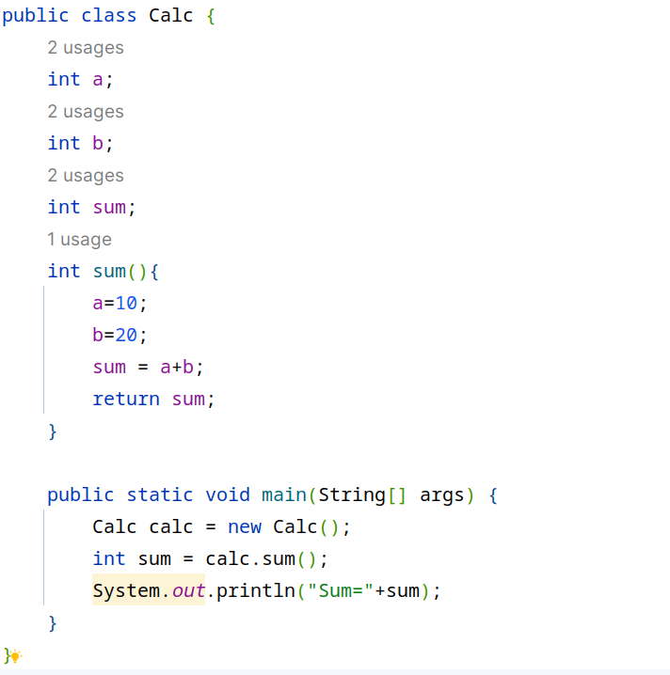

Methods : Methods that return value

Slide 6
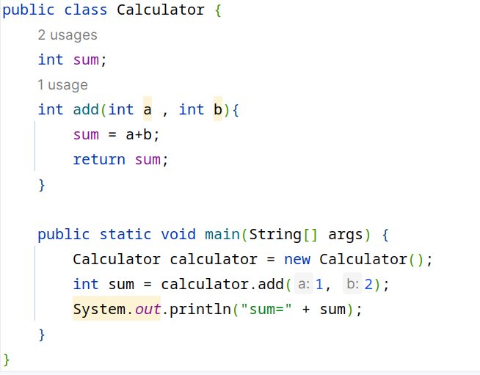

Methods : Methods that takes param

Slide 7
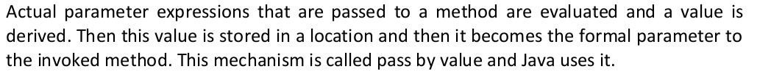
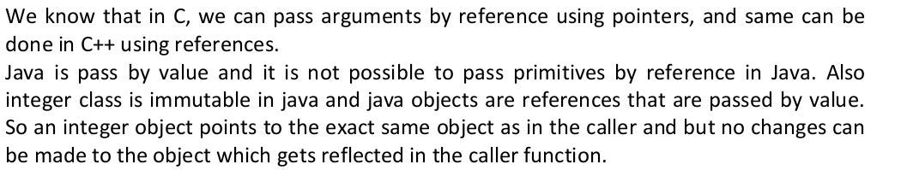
Methods : Pass by value / Pass by reference
Java supports pass by value i.e passing actual values to the methods

Slide 8
Constructors
Special methods
no return type
name of Class
default / non parameterized constructor is created when a class is created
is invoked while creating object
can define more than one constructor
if parameterized constructor is defined then a non parameterized constructor also should be defined

Slide 9
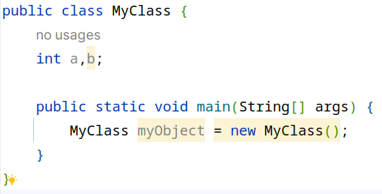
Constructors : Default / nullary / non-parameterized / no-arguments
In this example we have not defined MyClass() constuctor, but it is created by default and is used to create object , when a object is created from this , default int values are taken for values of a and b

Slide 10
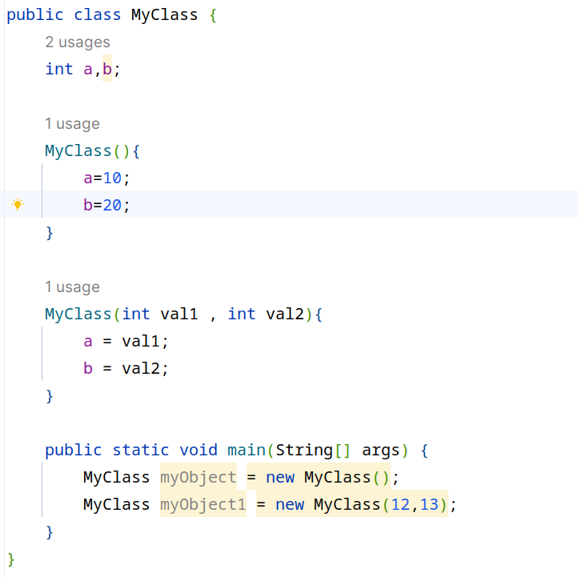
Constructors : Parameterized constructor
In this example , we have defined 2 constructors
MyClass() : when a object is created from this constructor , the value of a is 10 and b is 20 for each object
MyClass(int val1, int val2 ) : when a object is created from this constructor, 2 values must be passed such that val1 will be assigned to a and val2 will be assigned to 2

Slide 11
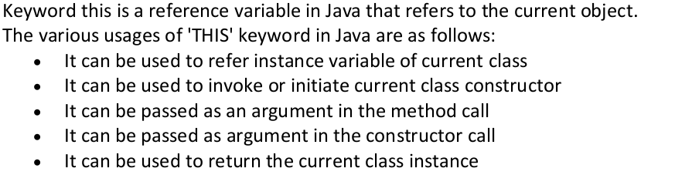
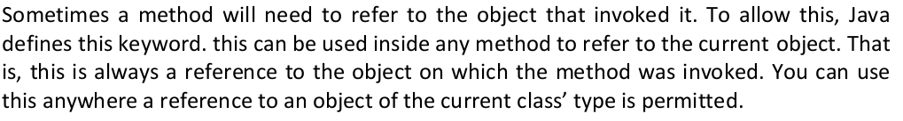
this keyword

Slide 12
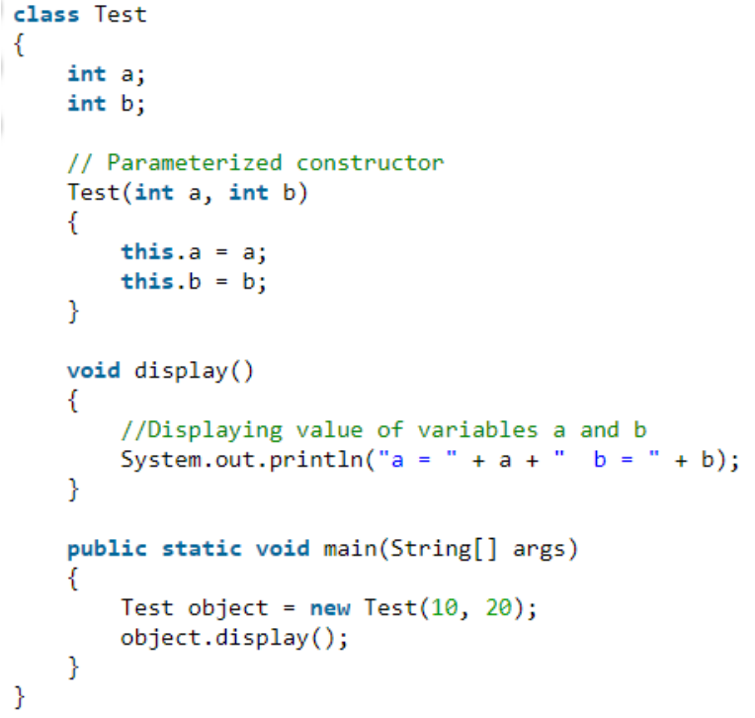
this keyword

Slide 13
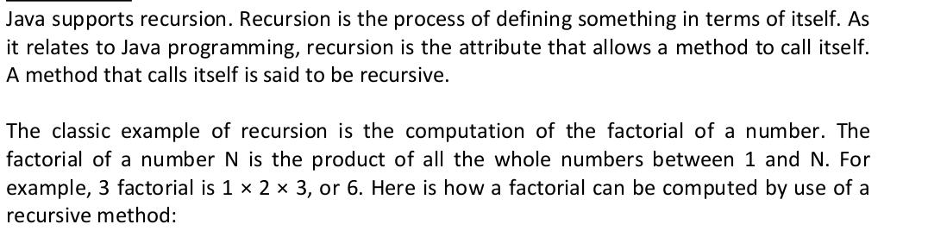
Recursion

Slide 14
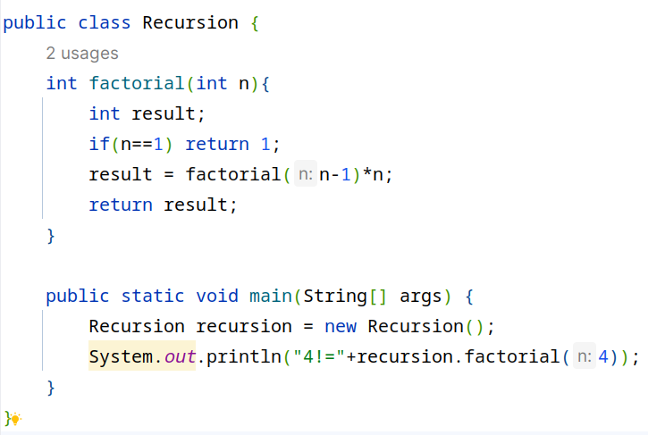

Recursion

Slide 15
Now lets revise the static keyword
We know that methods defined inside a class can be accessed through objects
But there might be certain instances that a method or variable might not depend on object but the class itself and that is “static”
Lets see an example where we have a static and a non staic variable and a method is used to increase them and print , lets see the difference

Slide 16
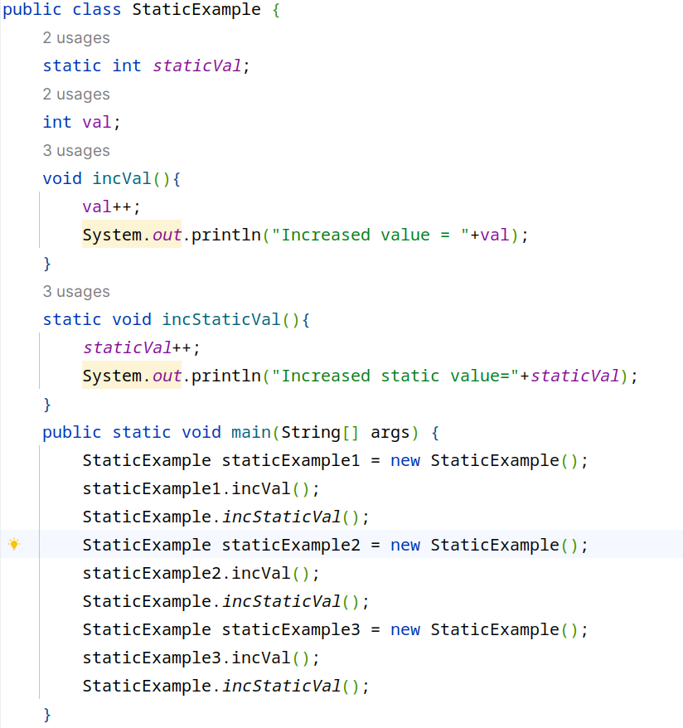
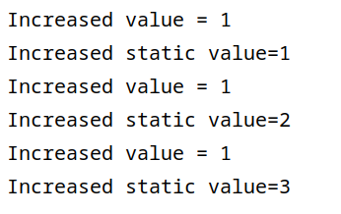
Now lets revise the static keyword

Slide 17
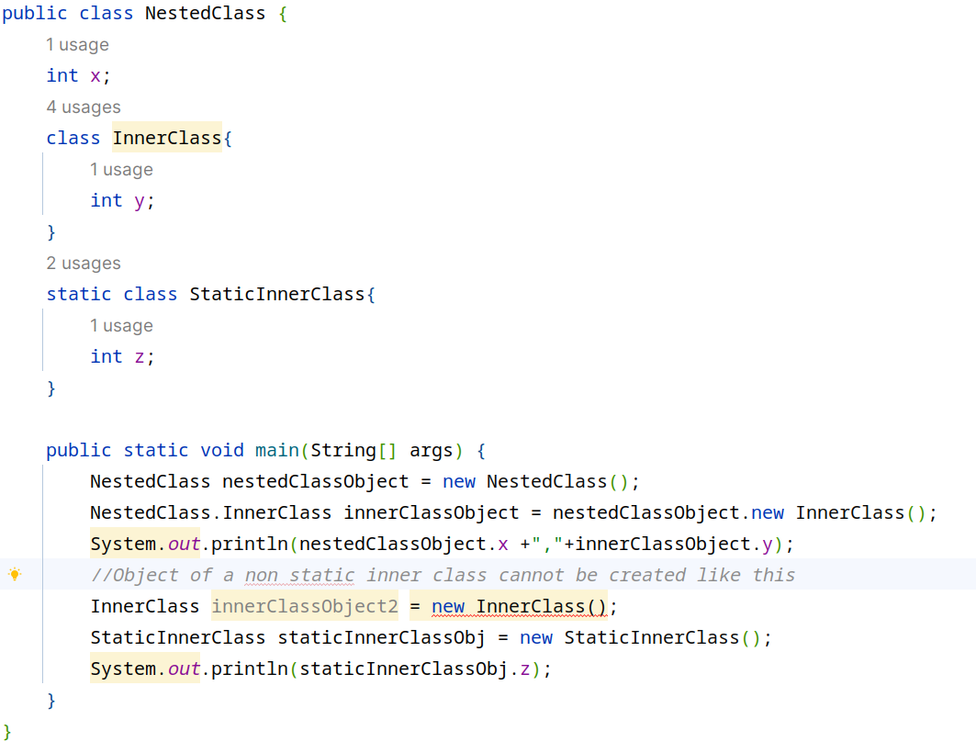
Inner / Nested Class and static Inner Class

Slide 18
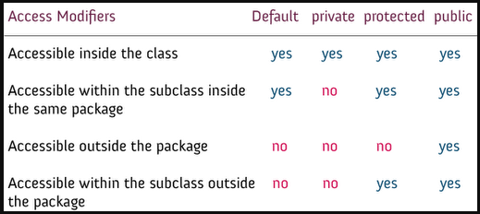
Access Control with specifiers/modifiers

Slide 19
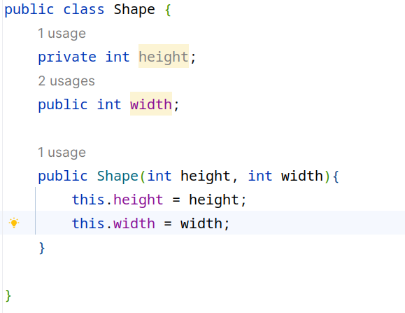
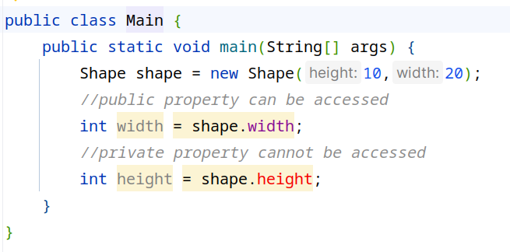
Access Control with specifiers/modifiers

Slide 20
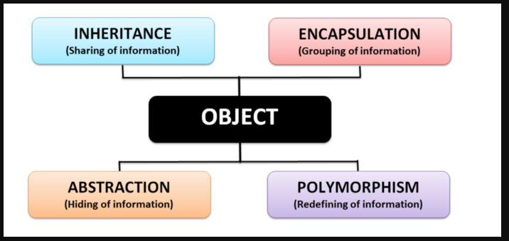
OOP Features

Slide 21
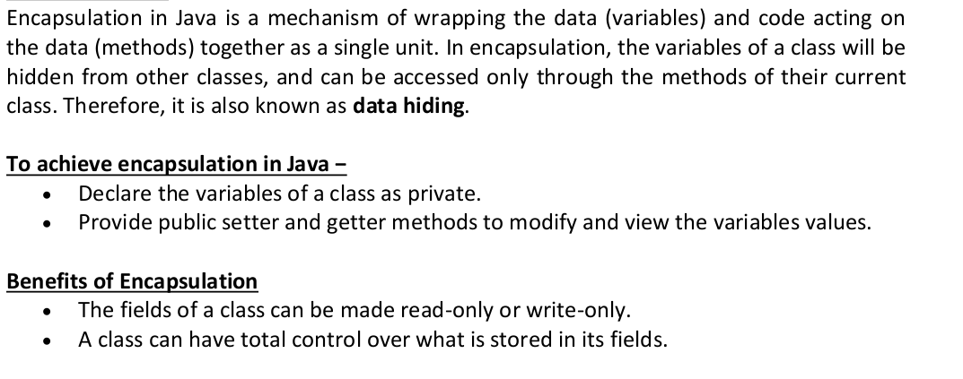
Encapsulation

Slide 22
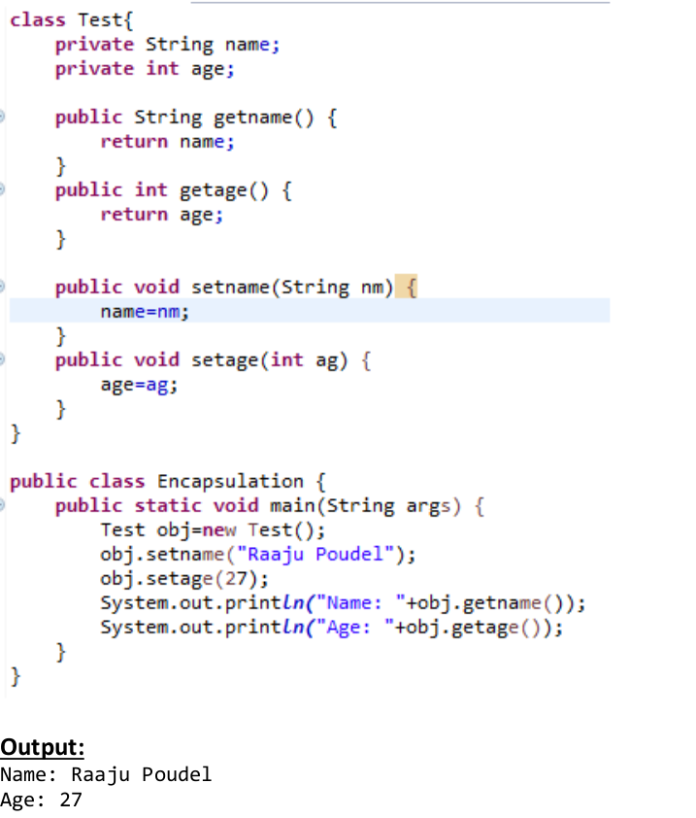
Encapsulation

Slide 23
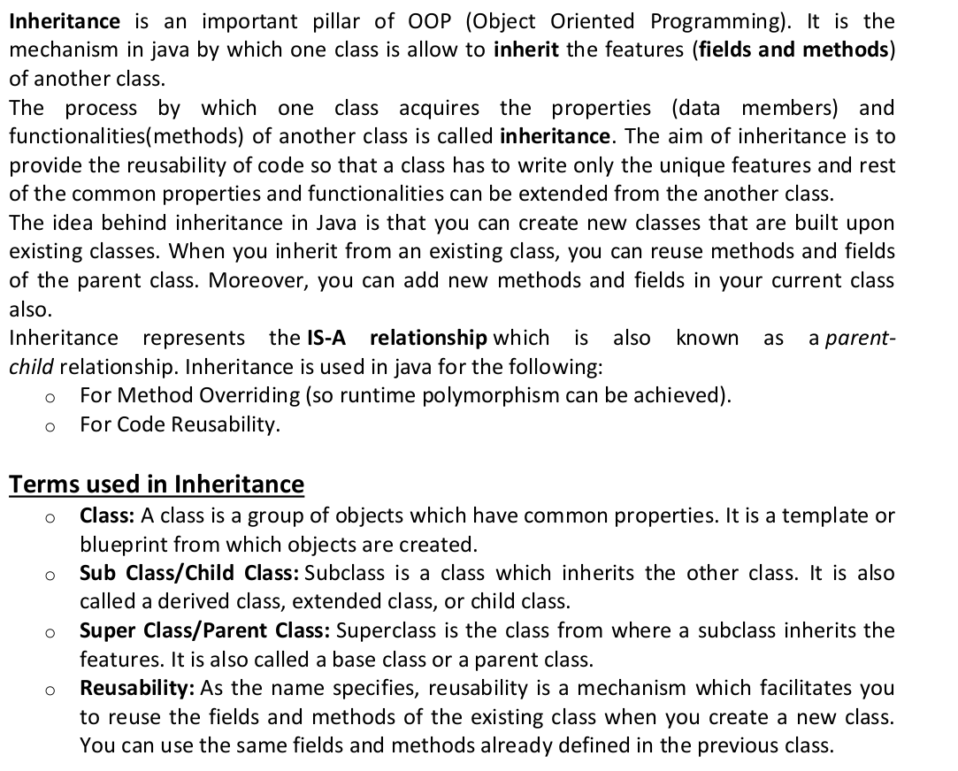
Inheritance

Slide 24
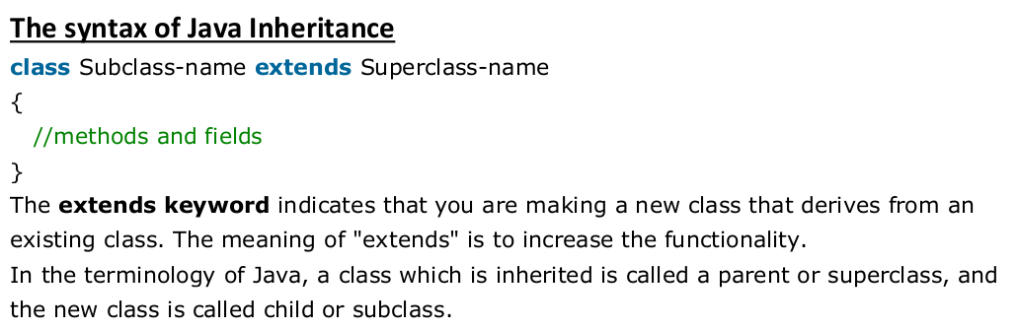
Inheritance

Slide 25
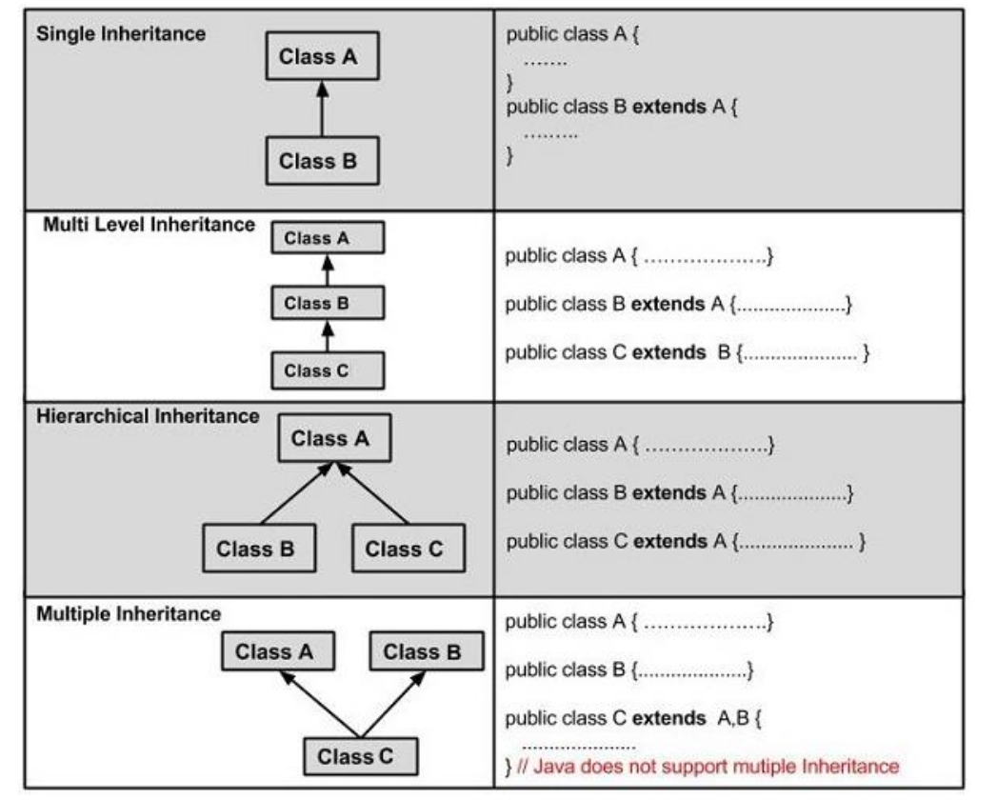
Inheritance : Types

Slide 26
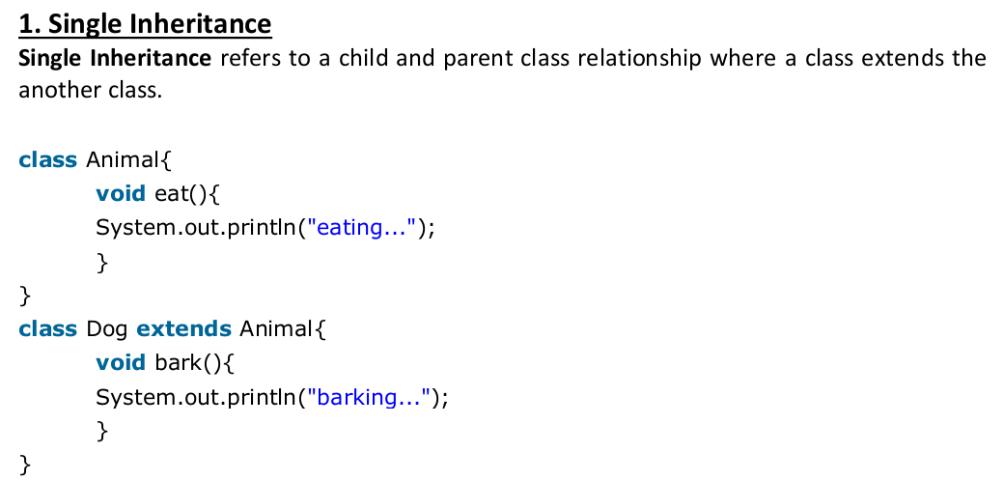
Inheritance : Types

Slide 27
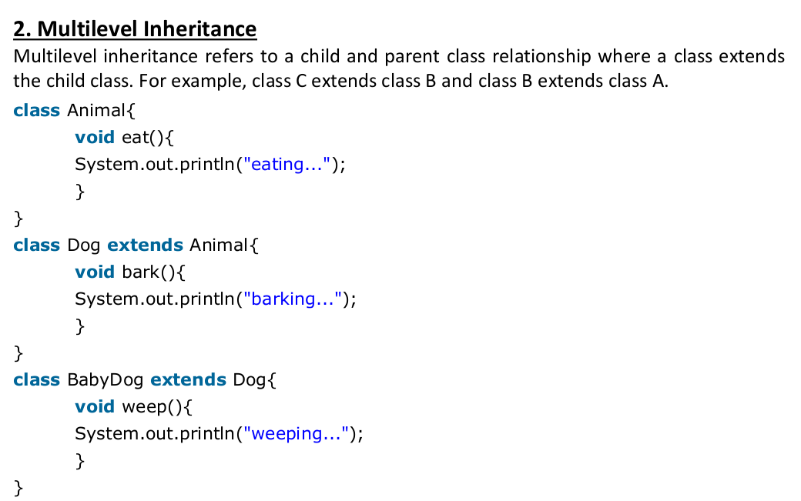
Inheritance : Types

Slide 28
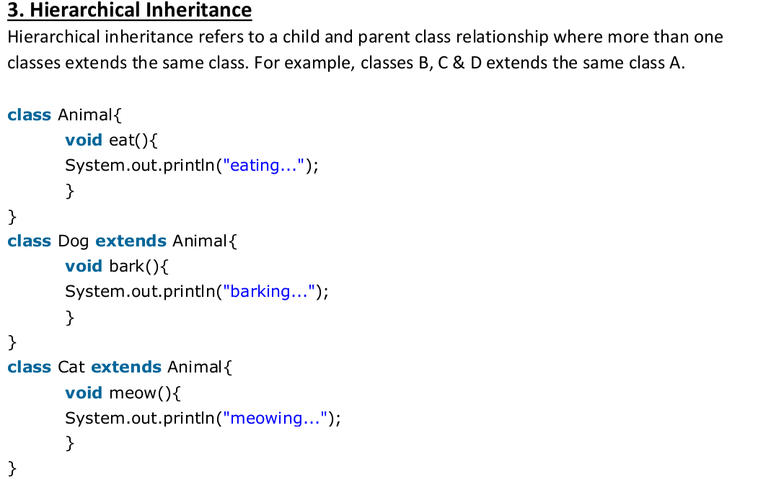
Inheritance : Types

Slide 29
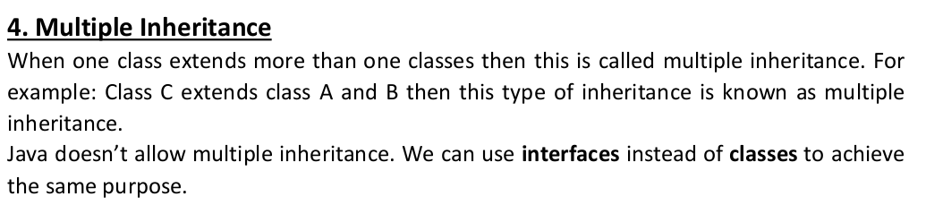
Inheritance : Types

Slide 30
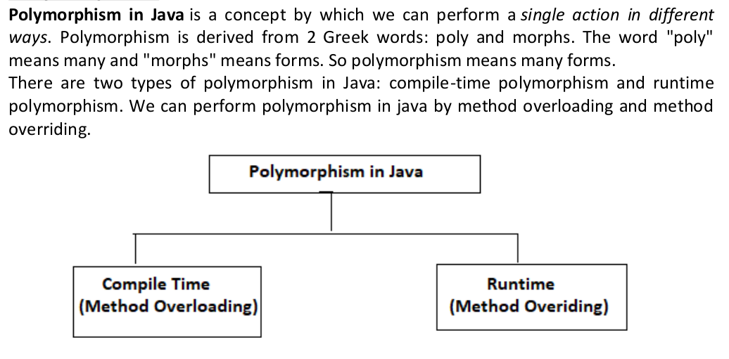
Polymorphism

Slide 31
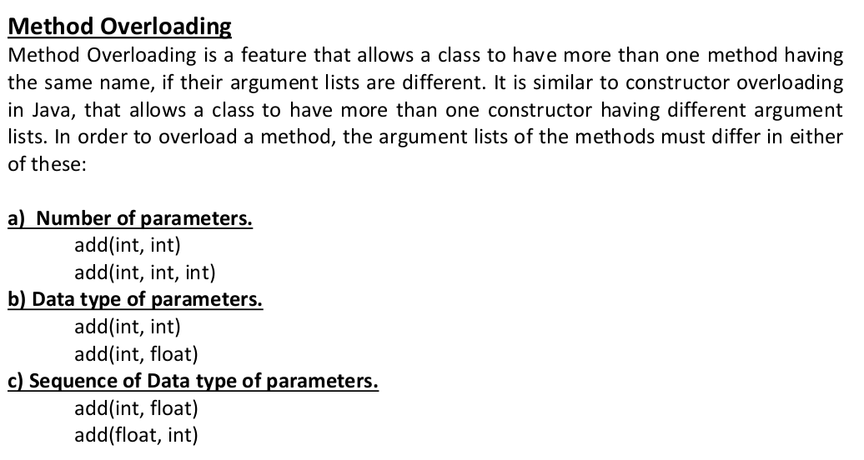
Polymorphism : Overloading

Slide 32
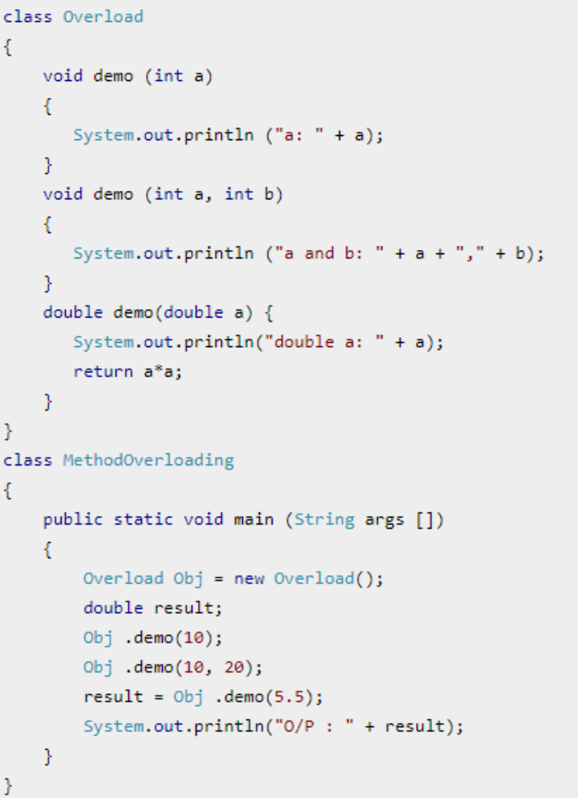
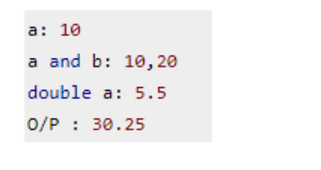
Polymorphism : Overloading

Slide 33
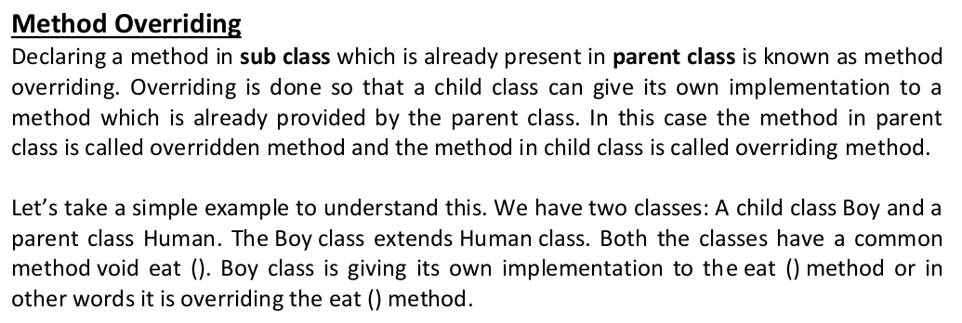
Polymorphism : Overriding

Slide 34
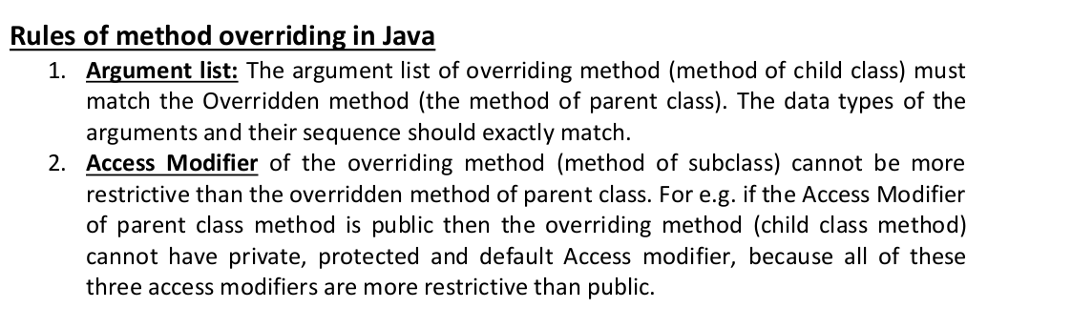
Polymorphism : Overriding

Slide 35
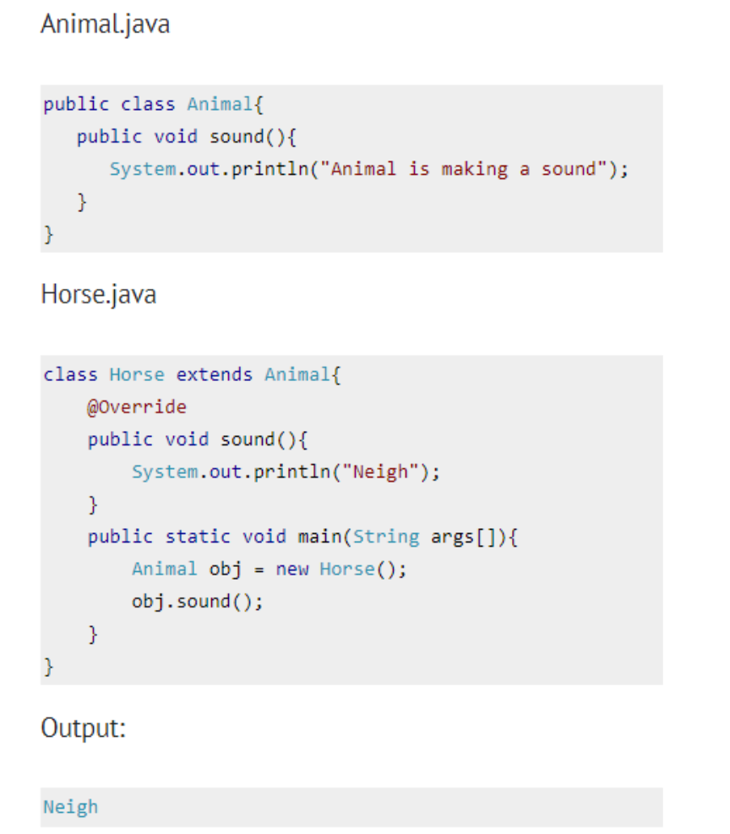
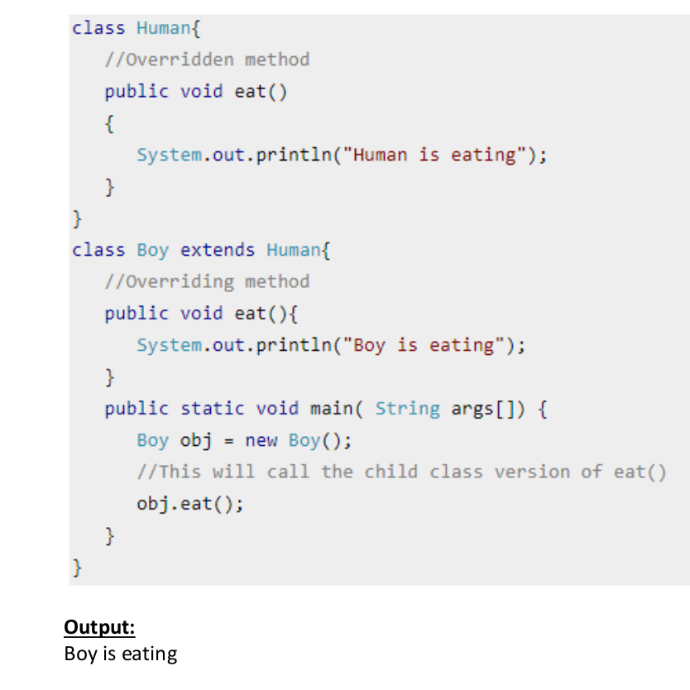
Polymorphism : Overriding

Slide 36
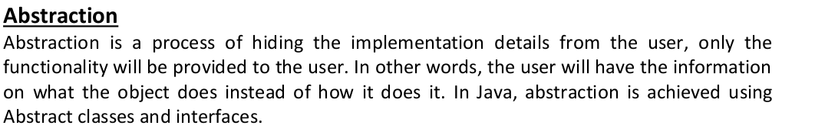
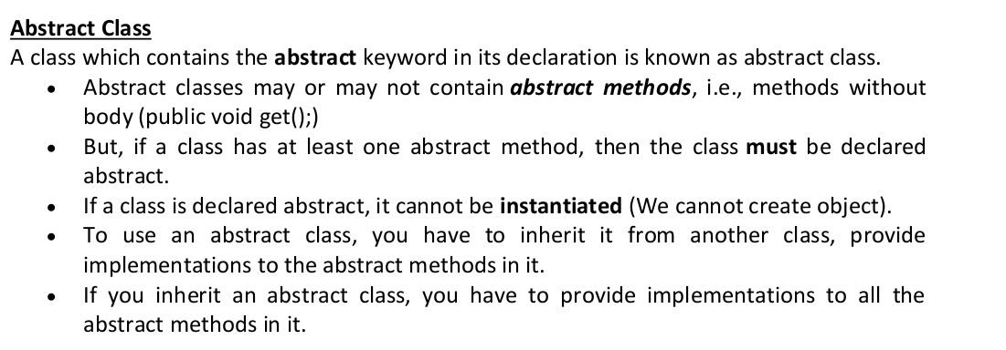
Abstraction : Abstract Class

Slide 37
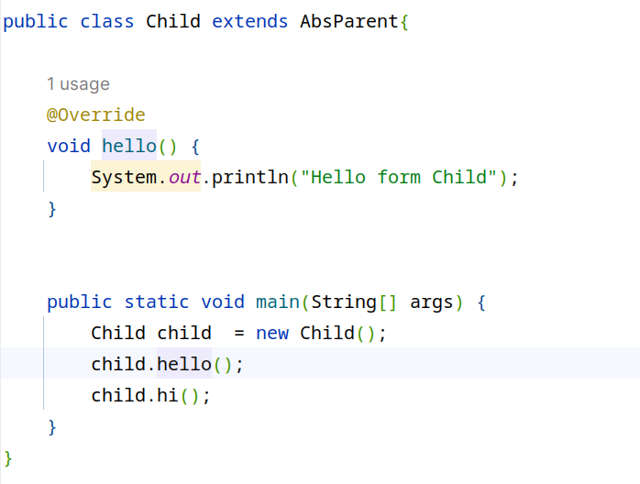
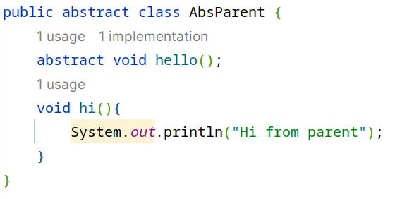
Abstraction : Abstract Class

Slide 38
Abstraction : Interface
Interfaces
pure abstraction
all methods are abstract by default no abstract keyword required
Class inheriting interface shall use implements keyword
Multiple Inheritance in Java can be achieved via interfaces

Slide 39
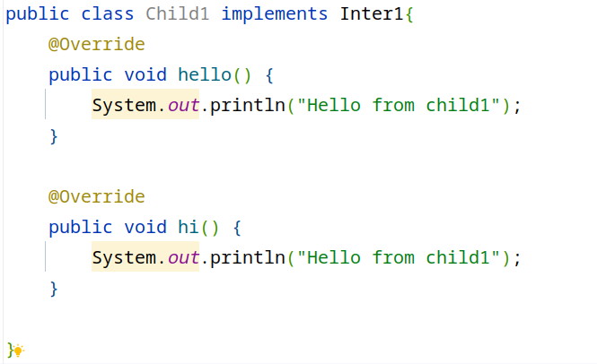
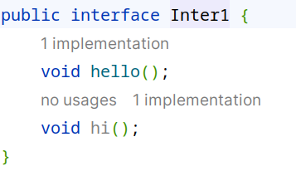
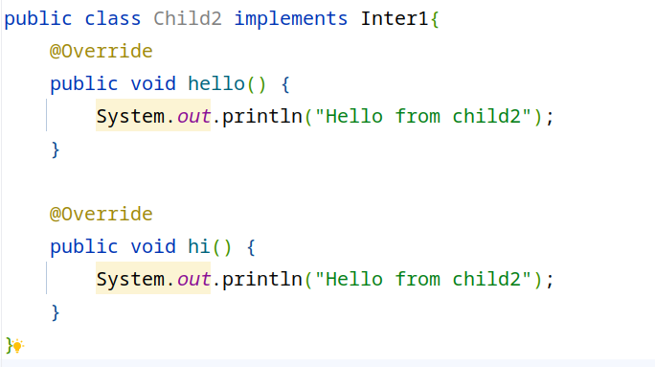
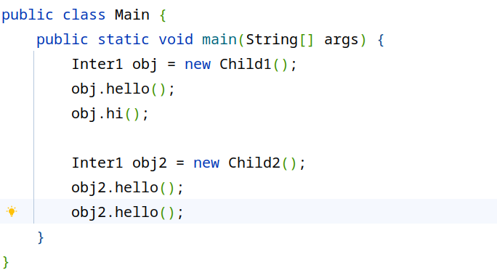
Abstraction : Interface

Slide 40
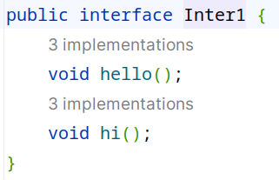
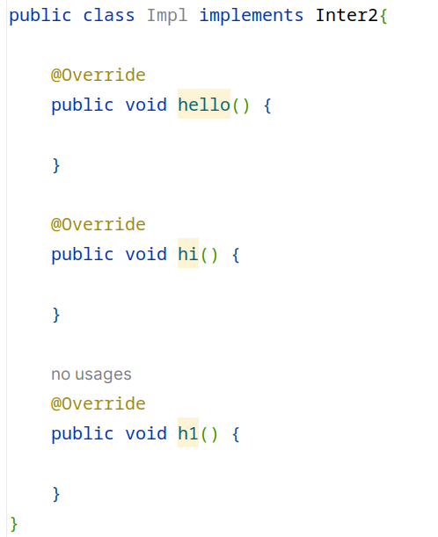
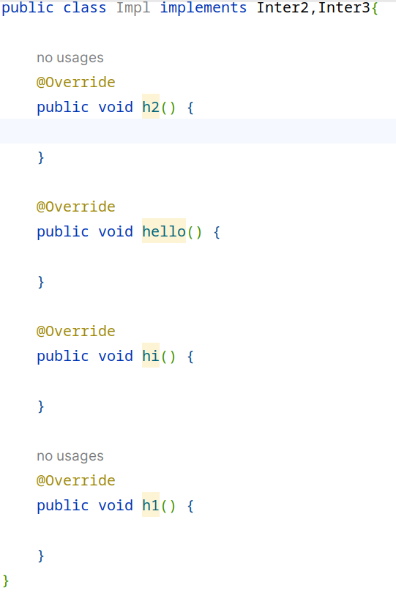
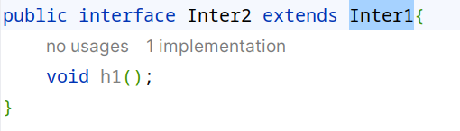
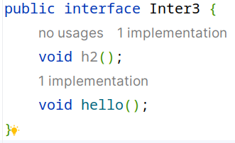

Slide 41

Interface in inherritance contd...

Slide 42

Dynamic Method Dispatch

Slide 43

Dynamic Method Dispatch

Slide 44
super keyword
reference variable that is used to refer parent class objects
usage
with variables
when variables with same name are present in both parent and child
with methods
when methods with same name are present in both parent and child
with constructors
access parent class constructor
can be used with both parameterized and non parameterized constructor

Slide 45





Slide 46




Slide 47


Constructor Chaining using this

Slide 48
final keyword
usage
in variables
to make them constant
in methods
to avoid overriding
in classes
to avoid inheriting

Slide 49


Slide 50

Package

Slide 51

Package

